Slide 1

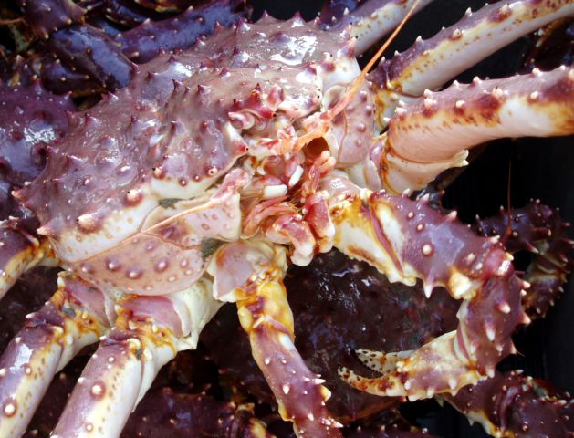
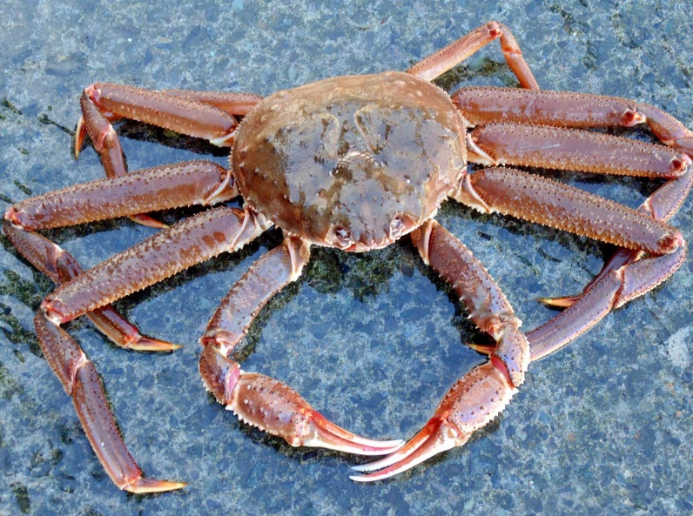
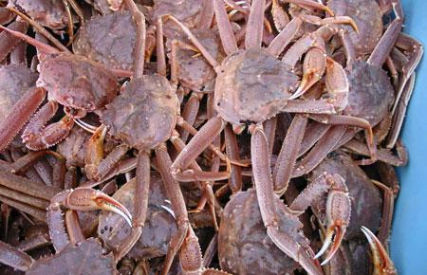
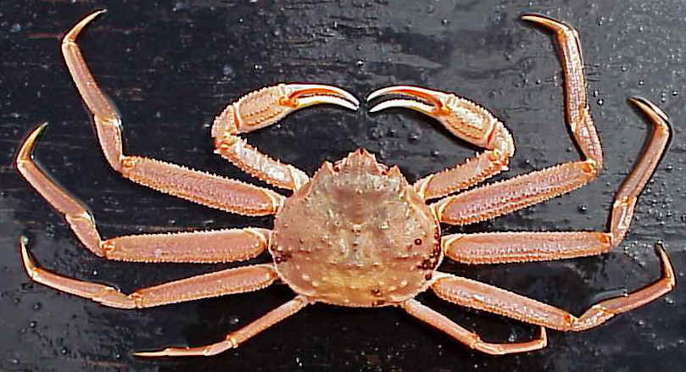
Shell condition and temperature-derived updates to the length-weight relationships for three eastern Bering Sea crab stocks
Jonathan Richar
Jon.richar@noaa.gov
Alaska Fisheries Science Center
Kodiak Laboratory

Slide 2
Objectives
Update model parameters used to calculate biomass estimates based on size-weight relationships
Allowing for factors affecting the relationships that were not accounted for in work that developed currently used parameters (Chilton 2009, 2011)
Red king crab, tanner crab, opilio crab
Shell condition
Red king crab only
Thermal regime of given survey year

Slide 3
Background
Current S-W parameters based on work conducted in late 2000s as an update to initial work done primarily in 1970s/1980s (Chilton 2011)
Data from 2006 to 2011
Relative to previous work, much larger sample sizes
Amalgamated across years/shell condition
Complicating factors not accounted for
Temperature: influences metabolism and tissue growth post-molt
Shell condition: Older shells more dense, and tissue fill greater

Slide 4
Current parameters
Species | a | b | Sample size
Red king crab - males | 0.000403 | 3.141334 | N = 1092
Tanner crab - males | 0.00027 | 3.022134 | N = 1131
Opilio crab - males | 0.000267 | 3.097253 | N = 1109

Slide 5
Importance of size-weight relationship
Used to calculate mature biomass population estimates for stock assessment/fishery management
by stock/management area
OFL calculation

Slide 6
Methods I
Up to date size-weight data
2000 – 2019
Collected randomly on the EBS summer bottom trawl survey
Clean (no/minimal epibionts), intact (no carapace cracks or missing/regenerating limbs)
Weight (g)
Digital scale
Carapace size (CL/CW) to 0.1mm
Vernier caliper (prior to 2016)
Digital caliper (2016 to present)

Slide 7
Methods II
Stock specific data grouped based on variable of interest
Outliers classified via Cook’s Distance and removed prior to analysis
Male Bristol Bay red king crab, EBS Bairdi, EBS opilio
Shell condition
Male Bristol Bay red king crab ONLY
New shell males grouped by warm/cold year, determined based on whether a late summer retow was conducted
Cold years: 2000, 2006, 2007, 2008, 2009, 2010, 2011, 2012, 2017
Warm years: 2001, 2002, 2003, 2004, 2005, 2013, 2014, 2015, 2016, 2018, 2019
Followup work to address blue king crab and females

Slide 8
Methods II cont.
 | N
Male BBRKC - NS | 1756
Male BBRKC - OS | 552
Male BBRKC - NS - cold | 1265
Male BBRKC - NS - warm | 491
Male Tanner crab - NS | 3314
Male Tanner crab - OS | 2064
Male Opilio crab - NS | 4531
Male Opilio crab - OS | 1979

Slide 9
Methods III
The size-weight relationship may be modelled as
Weight (g) = a *(Carapace size (mm))^{b}
Parameters a and b estimated separately
Iinear regression fitted to log-transformed size-weight data
Parameter a is the intercept in log-scale and log₋₁
Parameter b is the slope
Slopes compared to baseline estimates using t-tests
Biomass estimates calculated using final parameter estimates, and compared to baseline estimates calculated using current parameters

Slide 10
Results

Slide 11
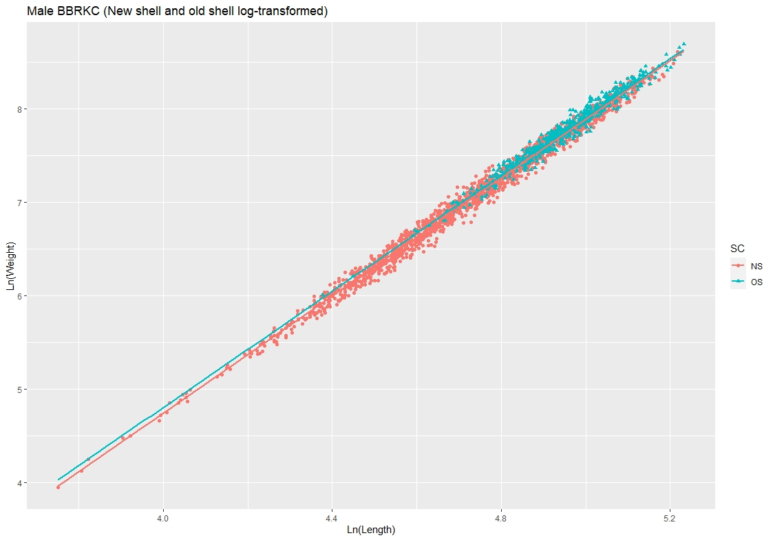
Male red king crab – shell condition
log(W_{OS}) = 0.000481 * CL^{3.111170}
R² = 0.97
Slope not significantly different from baseline
Slopes not different
From each other, though intercepts were
log(W_{NS}) = 0.00039 * CL^{3.147886}
R² = 0.99
Slope not significantly different from baseline

Slide 12
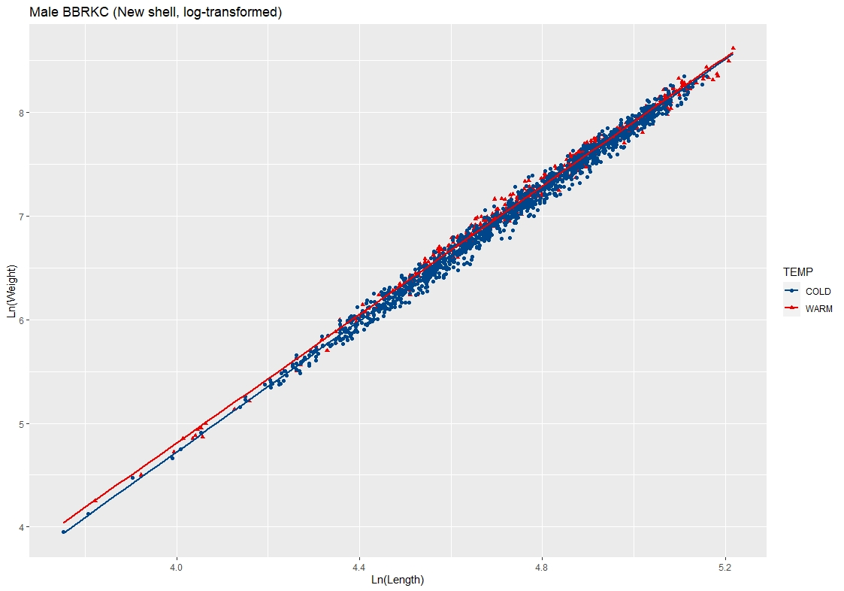
Male red king crab – NS - temperature
Log(W_{SC2warm}) = 0.000507 * CL^{3.099277}
Slope significantly different
R² = 0.99
Slopes differ from each other (p = 2e-16)
Log(W_{SC2cold}) = 0.000368 * CL^{3.157545}
Slope not significantly different
R² = 0.99

Slide 13
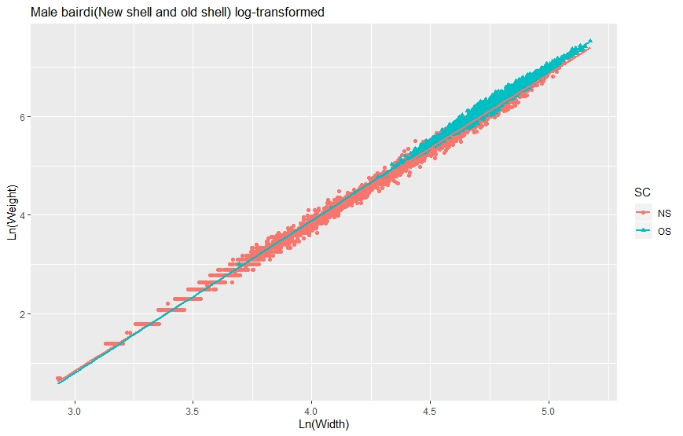
Male Bairdi crab – shell condition
Log(W_{OS}) = 0.000208 * CW^{3.091966}
Significantly different
R² = 0.98
Slopes and intercepts significantly different
Log(W_{NS}) = 0.000273 * CW^{3.014254}
Significantly different
R² = 0.99

Slide 14
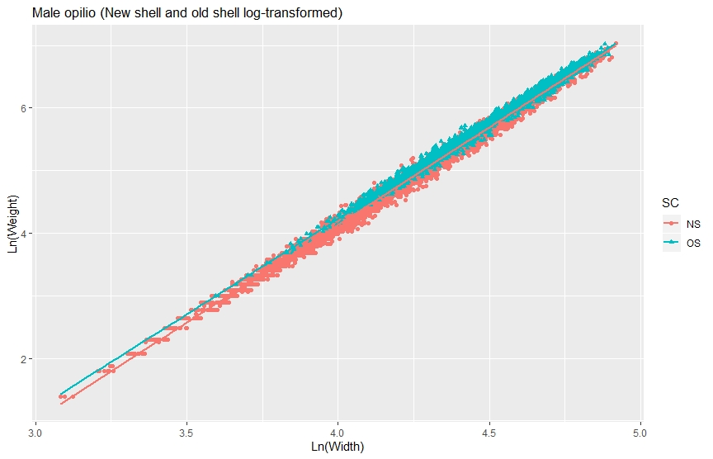
Male opilio crab – shell condition
Log(CW_{OS}) = 0.000343 * CW^{3.051748}
Significantly different from baseline
R² = 0.99
Slopes and intercepts significantly different
Log(CW_{NS}) = 0.000237 * CW^{3.119509}
Significantly different from baseline
R² = 0.99

Slide 15
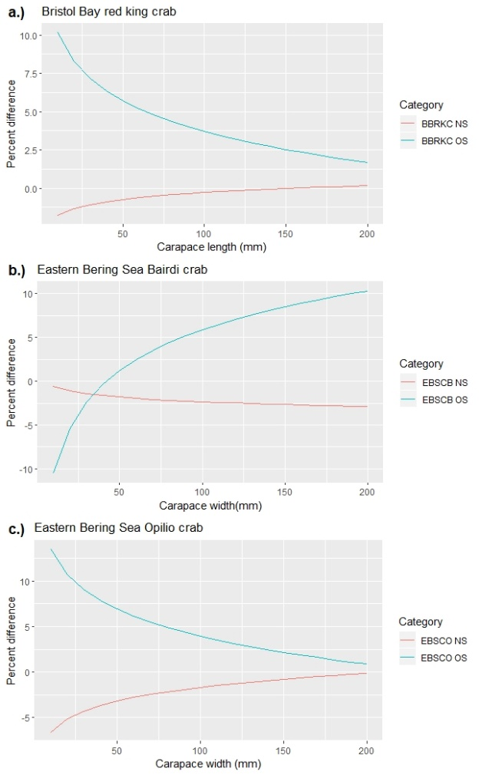
Calculated weight anomalies relative to current models

Slide 16
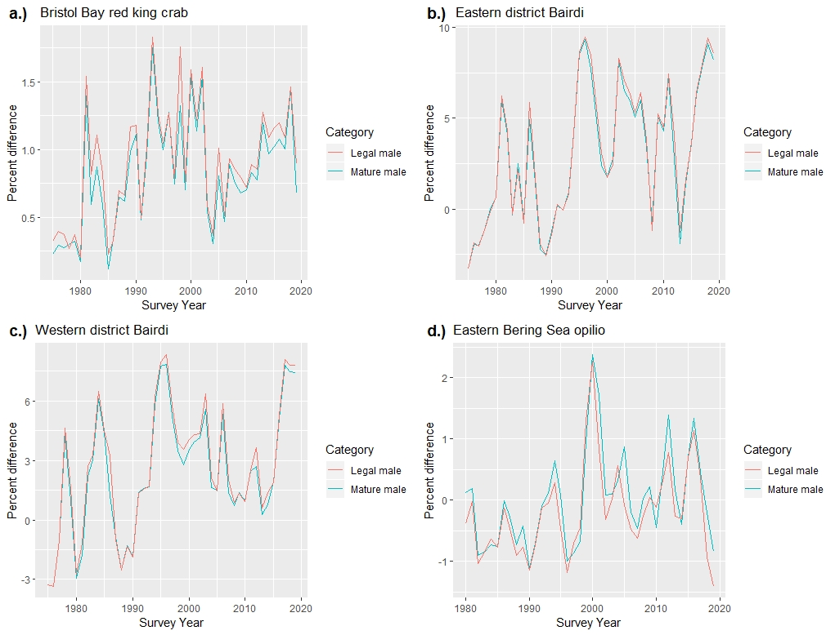
Time series biomass anomalies relative to baseline estimates

Slide 17
Literature cited
Chilton, E.A. 2009. Updates to size-weight relationships of eastern Bering Sea commercial crab species. Presentation.
Chilton, E.A. 2011. Size-weight relationships of commercial crab in the eastern Bering Sea.

Slide 18

Questions?

